Slide 1

Marketing Term Deposits
Chenyu Zhou
IDS 702
Final Project

Slide 2
Background
Term Deposit:
Low risks & Higher interest rates than saving accounts
Identify features leading consumers to purchase a term deposit
Are consumers who have purchased term deposits before more likely to purchase it again?
Term Deposit
Loan
Saver
Bank
Borrower
$$
$$$

Slide 3
Data
Marketing campaigns of a Portuguese bank from May 2008 to November 2010 (41,112 observations)
Response Variable: whether a consumer purchased a term deposit for a marketing campaign

Slide 4
Data
Consumer Characteristics | Age (agec) | History | Days Since Last Approach (pdays)
 | Job (job) |  | # of Previous Approached Campaigns (previous)
 | Education (education) |  | Result of Previous Campaigns (poutcome)
 | House Loan (housing) | Social and Economic Attributes | Employment Variation Rate (varc)
 | Personal Loan (personal) |  | Monthly Consumer Price Index (pricec)
Contact | Type (contact) |  | Monthly Consumer Confidence Index (confc)
 | Month (month) |  | Daily Euribor 3 Month Rate (euric)
 | Day of a Week (day_of_week)
 | # of Contacts for this Campaign (campaign)
Use MICE in R to create imputations for missing data

Slide 5
EDA
Outcome of previous campaigns:
Outcome of Previous Campaigns * CCI:
The relationship between CCI-centered and y seems to vary by previous campaign outcome
 | Failure | Nonexistent | Success
No | 0.86 | 0.91 | 0.35
Yes | 0.14 | 0.09 | 0.65

Slide 6

Model
M1 | ynum~ agec + job + marital + education + housing + loan + contact + month + day_of_week + campaign + poutcome + varc + pricec + confc + euric
M2 | ynum~ agec + job + marital + education + housing + loan + contact + month + day_of_week + campaign + poutcome + confc
M3 | ynum ~ poutcome + month + contact + job + confc + campaign + day_of_week + education + marital
M4 | ynum ~ poutcome + month + contact + job + confc + campaign + day_of_week + education + marital + poutcome:confc
$$\log\left(\frac{π_{i}}{1−π_{i}}\right)=β_{0}+β_{1}{poutcome}_{i}+β_{2}{month}_{i}+β_{3}{contact_type}_{i}+β_{4}{job}_{i}+β_{5}{confc}_{i}+β_{6}{num_campaign}_{i}+β_{7}{day}_{i}+β_{8}{education}_{i}+β_{9}{marital}_{i}+β_{10}{poutcome}_{i}∗{confc}_{i}+ε_{i}$$

Slide 7
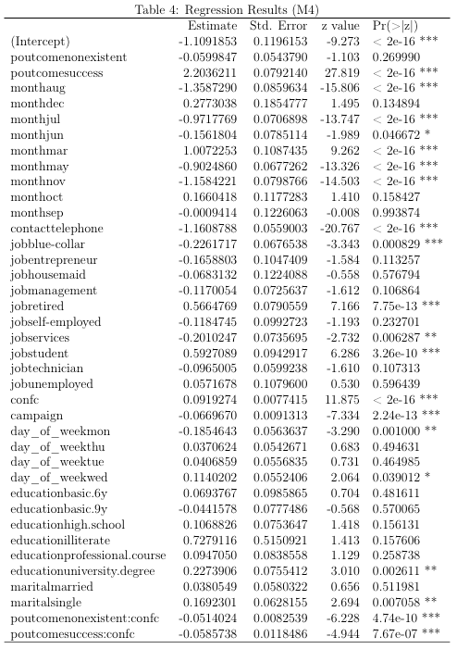

Findings
The expected odds ratio of purchasing a term deposit is 0.33 ($e^{−1.109}$) if the consumer is divorced, worked as an admin, with a basic 4-year education, and who is approached on a Friday in April by cell phone for the first time for this campaign. He or she has been approached for previous campaigns but has not bought any product, and the overall consumer confidence index is on the average level.
Compared to a consumer who did not agree to purchase a term deposit for previous campaigns, the odds ratio of purchasing a term deposit for this campaign increases by 9.06 ($e^{2.204}$) if the consumer has successfully purchased the product in previous campaigns.
When consumer confidence index increases by 1 unit, compared to a consumer who did not agree to purchase a term deposit for previous campaigns, the odds ratio of purchasing a term deposit for this campaign only increases by 1.03 ($e^{0.092−0.059}$) if the consumer has successfully purchased the product in previous campaign.
Accuracy: 0.80; Sensitivity: 0.59; Specificity: 0.93; AUC: 0.77

Slide 8
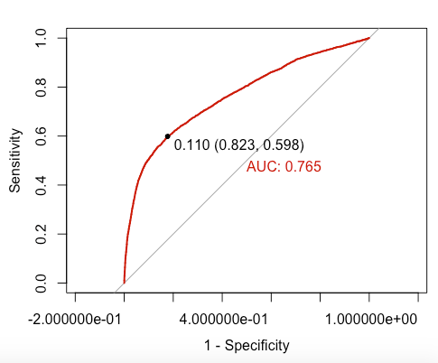

Findings
The expected odds ratio of purchasing a term deposit is 0.33 ($e^{−1.109}$) if the consumer is divorced, worked as an admin, with a basic 4-year education, and who is approached on a Friday in April by cellular for the first time for this campaign. He or she has been approached for previous campaigns but has not bought any product, and the overall consumer confidence index is on the average level.
Compared to a consumer who did not agree to purchase a term deposit for previous campaigns, the odds ratio of purchasing a term deposit for this campaign increases by 9.06 ($e^{2.204}$) if the consumer has successfully purchased the product in previous campaigns.
When consumer confidence index increases by 1 unit, compared to a consumer who did not agree to purchase a term deposit for previous campaigns, the odds ratio of purchasing a term deposit for this campaign only increases by 1.03 ($e^{0.092−0.059}$) if the consumer has successfully purchased the product in previous campaign.
Accuracy: 0.80; Sensitivity: 0.59; Specificity: 0.93; AUC: 0.77

Slide 9
Discussion
Consumers who have purchased term deposits before are more likely to purchase again.
The effect of previous campaign outcome decreases a lot when consumers are more confident about future economy.
Future Direction
Hierarchical Model by contacted month / contacted day

